Slide 1

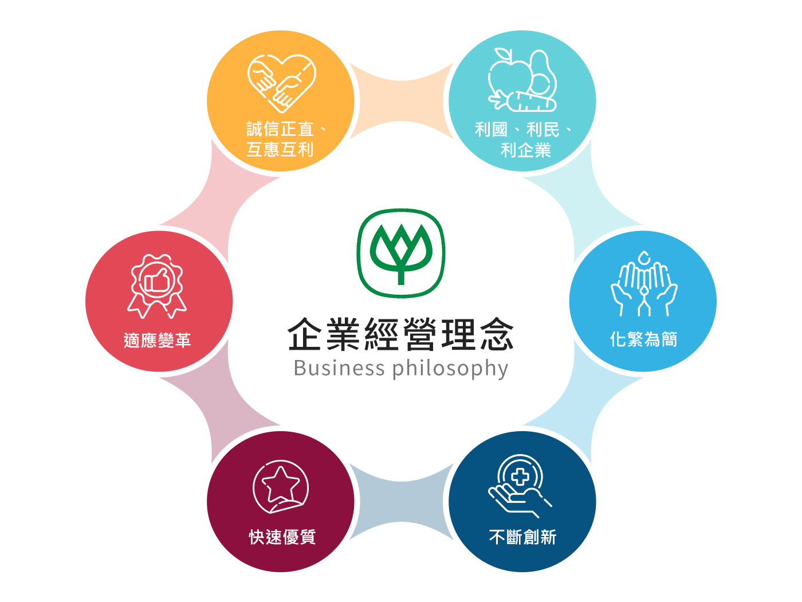
Charoen Pokphand Enterprise
Taiwan CO.LTD
Investor Conference

Slide 2
產業與營運概況-飼料產業

Slide 3
產業與營運概況-飼料產業

Slide 4
產業與營運概況-肉品加工產業
2016-2025 Import Volume of Chicken
Unit：Ton
2016-2025 Slaughter Volume of White-meat Chicken
Unit：Piece
2020-2025 Yearly Origin Price of Live Chicken
Unit：NTD/KG

Slide 5
產業與營運概況-養豬產業
2017-2025 (May) Import Volume of Pork
2017-2025 (May) Slaughter Volume of Pork
Unit：Ton
Unit：Piece
2020-2025 (Feb.) Yearly Price of Live Pig
Unit：NTD/KG

Slide 6
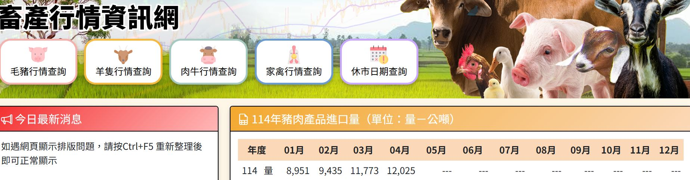
產業與營運概況-養豬產業
Livestock Market Quotation System
Swine Quote
Lamb Quote
Beef Quote
Poultry Quote
Market Closed Date
2025 Pork Import Volume (Unit: Tons)
Year Jan. Feb. Mar. Apr. May Jun. Jul. Aug. Sep. Oct. Nov. Dec.

Slide 7
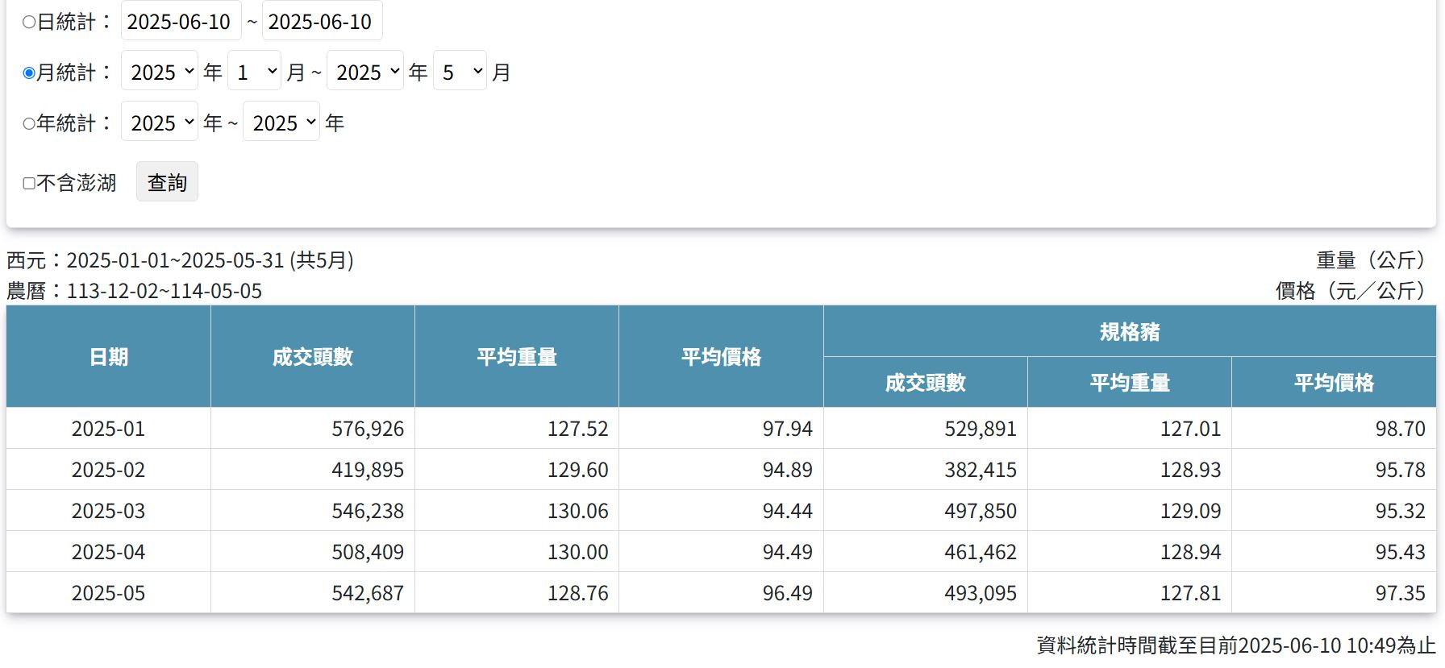
產業與營運概況-養豬產業
Daily: Jun. 10, 2025—Jun. 10, 2025
Monthly: Jan. of 2025—May of 2025
Yearly: 2025—2025
From Jan. 1, 2025 to May 31, 2025 (5 Months)
Standardized Pig
Date
Deal Piece
Average Weight
Average Price
Average Weight
Average Price
Deal Piece

Slide 8
Consolidated IS（Three months ended Mar.31 2025 & 2024）
Amount：Million TWD
Notes:
Data-FS.xlsx \ PL(quarter)

Slide 9
Consolidated BS （As for Mar. 31 2025 & 2024）
Amount：Million TWD
Notes:
Data-FS.xlsx \ BS

Slide 10
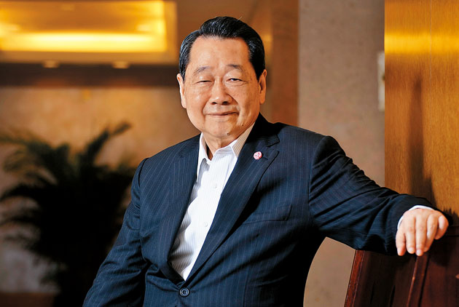
C S R
Chairman Dhanin of CP Group
By following the business philosophy of 『Benefit Country, Benefit People, Benefit Company』, we always require all of our employees not only to take account of our economics, corporate social responsibility, environmental protection while executing our policies, but also to do their full efforts to ensure consumer food safety and health

