Slide 1

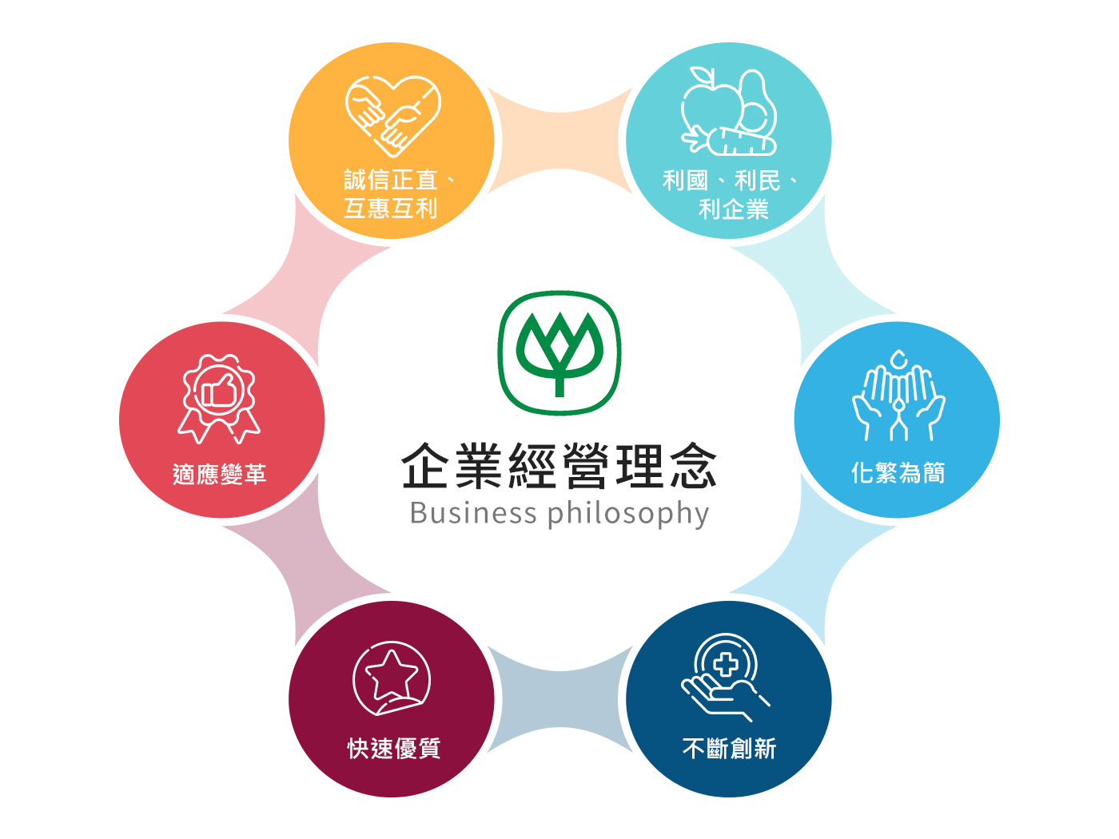
Charoen Pokphand Enterprise
Taiwan CO.LTD
Investor Conference

Slide 2
Industrial & Operational Overview -Feeds
Corn—Futures Price
Soybean—Futures Price

Slide 3
Industrial & Operational Overview –Meat Processing
2016-2025 Import Volume of Chicken
2016-2025 Slaughter Volume of White-meat Chicken
Unit：Ton
Unit：Piece
2020-2025 Yearly Origin Price of Live Chicken
Unit：NTD/KG

Slide 4
Industrial & Operational Overview - Pig Husbandry
2017-2025 (Feb.) Import Volume of Pork
Unit：Ton
2017-2025 (Feb.) Slaughter Volume of Pork
Unit：Piece
2020-2025 (Feb.) Yearly Price of Live Pig
Unit：NTD/KG

Slide 5
Consolidated IS（Year ended Dec.31 2024 & 2023）
Amount：Million TWD
Notes:
Data-FS.xlsx \ PL (YTD)

Slide 6
Consolidated BS （As for Dec. 31 2024 & 2023）
Amount：Million TWD
Notes:
Data-FS.xlsx \ BS

Slide 7
Quarterly Operating Performance（FY.2022- FY.2024）
Amount：Million TWD
Sales Revenue
Operating Margin
% Sales Growth
% Margin
Notes:
Data-FS.xlsx \

Slide 8
Key data -Operating Performance（FY.2013–FY.2024）
Amount：Million TWD
Notes:
Data-FS.xlsx \ Yearly

Slide 9
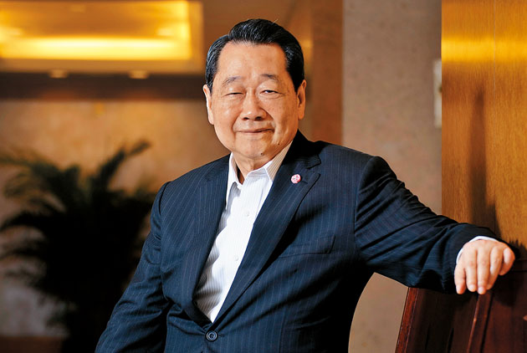
C S R
Chairman Dhanin of CP Group
By following the business philosophy of 『Benefit Country, Benefit People, Benefit Company』, we always require all of our employees not only to take account of our economics, corporate social responsibility, environmental protection while executing our policies, but also to do their full efforts to ensure consumer food safety and health

