Slide 1

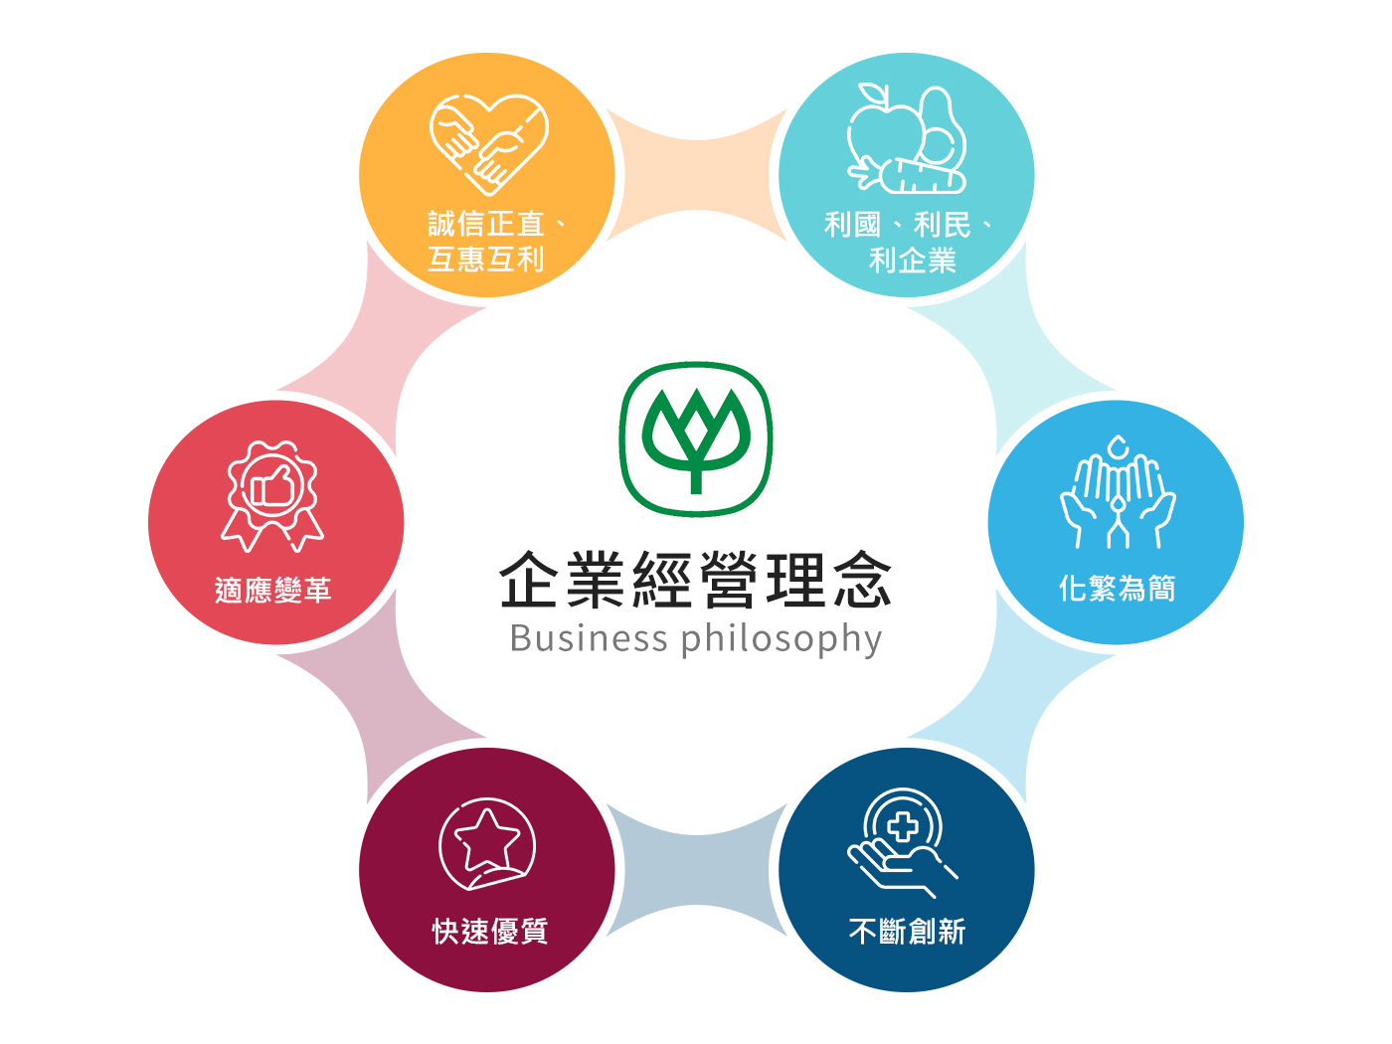
Charoen Pokphand Enterprise
Taiwan CO.LTD
Investor Conference

Slide 2
Industrial & Operational Overview -Feeds
Corn—Futures Price
Soybean—Futures Price

Slide 3
Industrial & Operational Overview -Feeds
Our company produced about 840 thousand tons in 2023, mainly for poultry and livestock feeds, with 15% market share. Our customers include self-operated farmers, contracted farmers and private farms, etc., most of them are located in central Taiwan with 62% market share, and 27% for southern & 11% for northern markets. In conformity with environmental & health and in order to provide safe & secure feed products for domestic breeding industry, our company has established a AI-automatic drug-free feed mill in Douliu, Yunlin County, which monthly capacity is more than 10 thousand now.

Slide 4
Industrial & Operational Overview -Fresh Chilled Meat
2015-2024 Import Volume of Chicken
2015-2024 Slaughter Volume of White-meat Chicken
Unit：Ton
Unit：Piece
2020-2024 Yearly Origin Price of Live Chicken
Unit：NTD/KG

Slide 5
Industrial & Operational Overview - Pig Husbandry
2017-2024 Import Volume of Pork
Unit：Ton
2017-2024 Slaughter Volume of Pork
Unit：Piece
2020-2024 Yearly Price of Live Pig
Unit：NTD/KG

Slide 6
Consolidated IS（Three months ended Sep.30 2024 & 2023）
Amount：Million TWD
Notes:
Data-FS.xlsx \ PL(quarter)

Slide 7
Consolidated IS（Nine months ended Sep.30 2024 & 2023）
Amount：Million TWD
Notes:
Data-FS.xlsx \ PL (YTD)

Slide 8
Consolidated BS （As for Sep. 30 2024 & 2023）
Amount：Million TWD
Notes:
Data-FS.xlsx \ BS

Slide 9
Quarterly Operating Performance（FY.2022- FY.2024）
Amount：Million TWD
Sales Revenue
Operating Margin
% Sales Growth
% Margin
Notes:
Data-FS.xlsx \

Slide 10
Key data -Operating Performance（FY.20112–FY.2024）
Amount：Million TWD
Notes:
Data-FS.xlsx \ Yearly

Slide 11
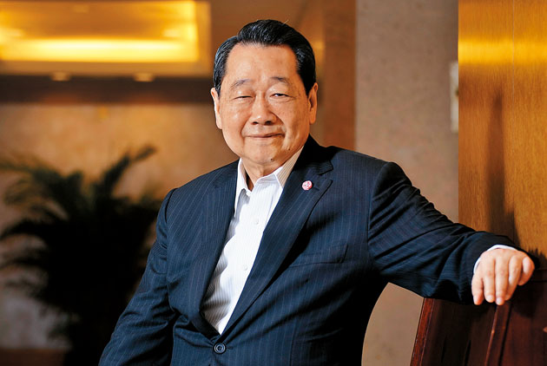
CSR
Chairman Dhanin of CP Group
By following the business philosophy of 『Benefit Country, Benefit People, Benefit Company』, we always require all of our employees not only to take account of our economics, corporate social responsibility, environmental protection while executing our policies, but also to do their full efforts to ensure consumer food safety and health

